Slide 1

Visual Presentation by:
Magnus Mejer Nielsen
Michael Magnus Ziegler
Marcus Rasmussen
Sandi Lemo

Slide 2
Business Economics
Relevant extract from assignment
Budgetting and forecast
Break-Even turnover
Profit & Loss statement
Elements of costs
Feedback from censors
Overall a good presentation of different economic tools, that a freelancer can use.
The tools on the left, are those that are most relevant, and can be used as a online economics course.

Slide 3
Project Management
Relevant extract from assignment
Project scope
Stakeholders
Project communication
Deliverables
Project planning
Feedback from censors
Some parts of the project management course, which we have described in the assignment, was not focused enough on digital freelancing, but the tools on the left, are the ones that a digital freelancer should be using, when working with companies.

Slide 4
Negotiation
Relevant extract from assignment
The negotiation part describes the different techniques that a digital freelancer should use, when negotiating with external partners/companies.
Feedback from censors
The whole negotiation part of the assignment, was recognized as being useful for a digital freelancer. Therefore it could be a good idea so read that part, since it may have some good inputs for further establishing of a negotiation online course

Slide 5
IT
Relevant extract from assignment
ERD diagram
Parts of the SQL code
Feedback from censors
The IT part of the assignment was not adequate enough. The SQL code was a bit to short, and needed some features and functions, if it is to be used as a real databasesystem.
The ERD diagram gave a good overview, but also needed some fine-tune.

Slide 6
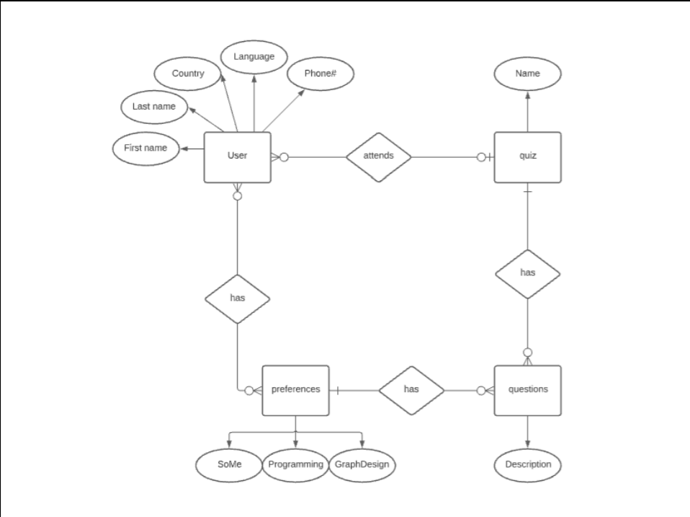
ERD Diagram

Slide 7
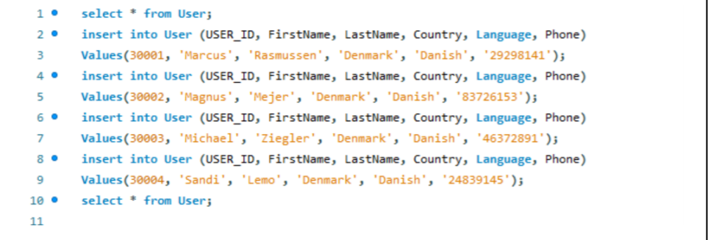
Snippet of DML-query (SQL)

Slide 8
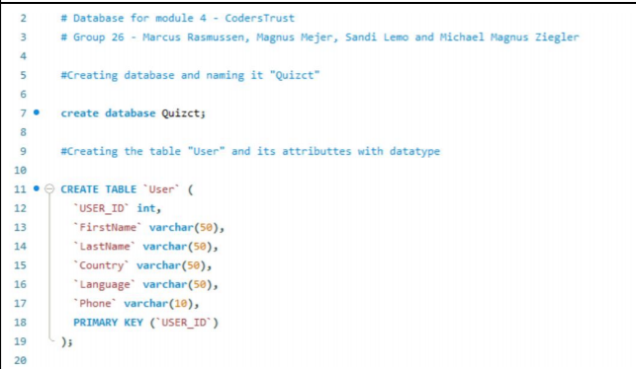
Snippet of DDL-query (SQL)

Slide 9


Slide 10
Quiz - Prototype
Relevant extract from assignment
The design
Thoughts behind our graphical expression
Feedback from censors
We got good feedback on our prototype of the quiz. They agreed with our thoughts behind our design, and acknowledged the fact, that it could be an inspiration to the further design of a quiz.

Slide 11
